Slide 1
Chat messaging app
Seth Lambert

Slide 2
Major features
User Profiles
Friends
Away Status
Messaging
GUI

Slide 3
User profiles
The basic user registration works the same as lab #3
User must have a unique username, password must be longer than 6 character
Usernames and profile information are stored in a text file, separated by tabs

Slide 4
Friends
The “friends” list is made up of all registered users.
The UserStatus text file holds the information in tab separated format
SETH ACTIVE User available
Users are either classified as ACTIVE or NOT_ACTIVE
Text file is changed when user logs in and out
The third column is the away message

Slide 5
Away Status
Stored in the third column of the UserStatus file
Default to user is not available when account is created and user is available once logged in
At the end of a session, the user can set a unique away message
Displays along with the friends list after login

Slide 6
messaging
Messages are stored in a text file called MessageQueue
When a message is sent it is added to the MessageQueue with one column being the sender and one being the receiver
At the same time the client checks the queue for available messages and prints them

Slide 7
GUI
GUI was built but not implemented
Using Python’s tkinter library
Windows for:
Greeting, New User, Existing User, Friends List, Chat box

Slide 8
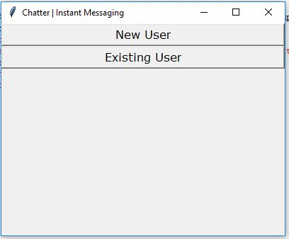
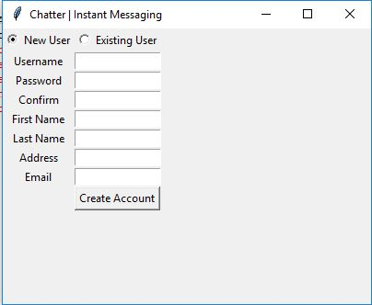
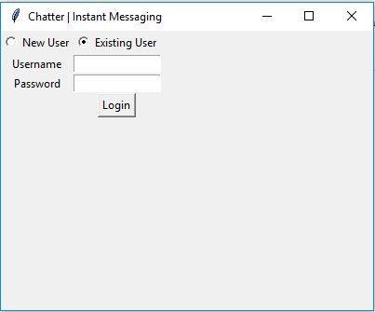
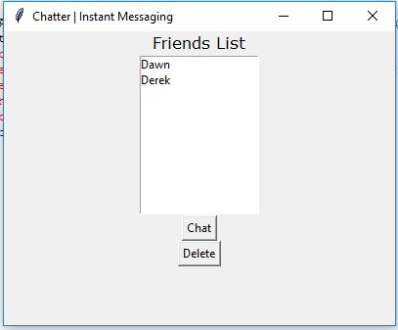
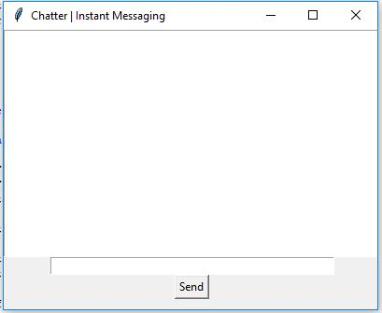

Slide 9
Bugs and errors
Messaging is not quite working.
Implementing with a text file as a queue is not the best way to do this
Works closer to email that instant messaging
If clients are improperly closed it breaks the text files and the program doesn’t work

Slide 10
What I learned
Python
Socket Programming
Design
Spent too much time on GUI and didn’t use it
Multi-threading

Slide 11
Moving forward
Project is a good extension of the socket programming labs
Next semester, I would suggest making this program a focus point
Since each lab built toward this, it could be more of a progressive experience
Incorporate Cloud Computing to disburse the chat apps live on the web

